Slide 1
Hands On: Cutting and Connectorizing UTP
Chapter 3a
Panko’s
Business Data Networks and Telecommunications, 5th edition
Copyright 2005 Prentice-Hall

Slide 2
UTP Recap

Slide 3
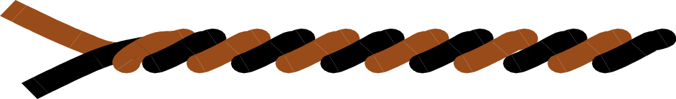
Recap: 4-Pair Unshielded Twisted Pair Cable with RJ-45 Connector
Four pairs (each pair is twisted) are enclosed in a jacket.
Single Twisted Pair
Jacket

Slide 4
Recap: 4-Pair Unshielded Twisted Pair Cable with RJ-45 Connector, Continued
The cord terminates in an 8-pin
RJ-45 connector, which plugs
into an RJ-45 jack in the NIC,
hub, or switch.
Pin 1 on this side
Unshielded
(no metal
shielding around
the 4 pairs)
RJ-45
Connector
RJ-45
Jack

Slide 5
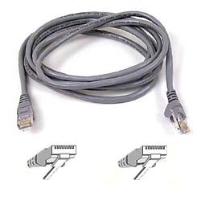
Recap: 4-Pair Unshielded Twisted
Pair Cable with RJ-45 Connector, Continued
UTP Cord
RJ-45
Connector

Slide 6
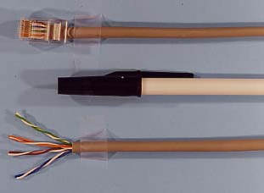
Recap: 4-Pair Unshielded Twisted
Pair Cable with RJ-45 Connector, Continued
RJ-45
Connector
Pen
4 Pairs
Separated

Slide 7
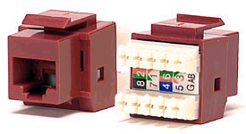
RJ-45 Plug in Wall Jack
Has push-in prong connectors for 8 wires in back
Front:
RJ-45 Jack
Back:
8 Wire Connectors

Slide 8
Types of UTP

Slide 9
Solid-Wire Versus Stranded-Wire UTP
Solid-Wire UTP
  Each of the eight wires is a solid wire surrounded by insulation
  Solid wires have low attenuation and so can reach 100 meters
  Easy to connectorize (add connectors to)
  Brittle and easy to break if handled roughly. Not good for runs through open office areas

Slide 10
Solid-Wire Versus Stranded-Wire UTP, Continued
Stranded-Wire UTP
  Each of the eight “wires” is really several thin strands of wire surrounded by insulation
  Flexible and rugged: ideal for running around an office area
  Higher attenuation than solid-wire UTP so can only be used in short runs—up to about 10 meters

Slide 11
Patch Cords Versus Bulk Wire
Patch Cords
  Cut to popular lengths and connectorized at the factory
  Tested for quality
  Use stranded-wire UTP, which is sufficiently rugged for open office areas
  TIA/EIA-568 specifies patch cords for the run from the wall jack to the desktop because it is rugged and flexible

Slide 12
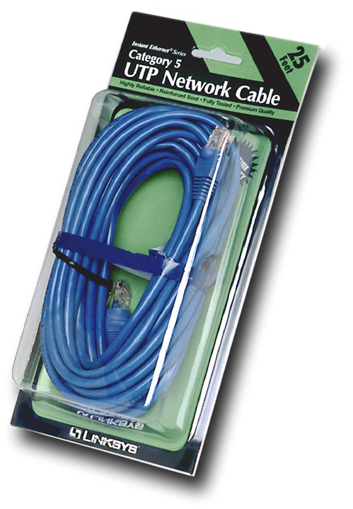
Patch Cords Versus Bulk Wire, Continued
Patch Cords
  Come in packages
  At your local computer store
  Available in a variety of lengths

Slide 13
Patch Cords Versus Bulk Wire, Continued
Bulk Wire
  Comes in spools of 50 meters or more
  Can be cut to precise lengths needed to connect devices
  Solid-wire UTP for longer distance and to make connectorization easier
  Cut, connectorized, and tested by the user, by the organization, or by a LAN installer
  Focus of this chapter

Slide 14
Cutting UTP

Slide 15
Cutting UTP
Cut a desired length of UTP
Make it a little longer than you need
  Adding a connector can take a few inches
  If the connectorization doesn’t test well, you will have to cut the end and install a new connector
  UTP cord should never be pulled tautly; it can beak if subjected to pulls. Should be slack after installation
Now do it!

Slide 16
Stripping the Cord

Slide 17
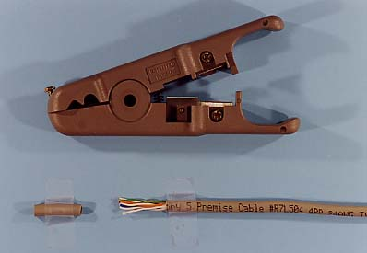
Stripping the Cord
You must strip the jacket 3 to 5 cm (1 to 2 inches) at each end
Stripper
Put Cord
Here
Stripped
Jacket

Slide 18
Stripping the Cord, Continued
Stripper scores the jacket (cuts into the jacket without cutting through it) to avoid damaging the wires inside the jacket
Stripper is rotated once around the cord to score it evenly
The tip of the cord is pulled off after the scoring, exposing 3 to 5 cm (one to two inches) of the wires
Now do it!

Slide 19
Putting the Wires in Order

Slide 20
Putting Wires in Order
There are orange, green, blue, and brown pairs
Each pair has one wire with solid-color insulation and one wire that is white with bands of the pair’s color
These wires will be placed in a particular order in the RJ-45 connector

Slide 21
Putting Wires in Order, Continued
There are two popular color schemes in TIA/EIA-568
  T568A and T568B
  T568B is the most commonly used color scheme in the United States we will use it
Note that T568A is a part of the TIA/EIA-568 standard, as is T568B

Slide 22
Putting Wires in Order, Continued
Pin | Color
1 | White-Orange
2 | Orange
3 | White-Green
4 | Blue
5 | White-Blue
6 | Green
7 | White-Brown
8 | Brown
Pin 1 on this side
on both ends
of the cord
T568B
RJ-45
Connector
RJ-45
Jack

Slide 23
Putting Wires in Order, Continued
Pin | Color
1 | White-Orange
2 | Orange
3 | White-Green
4 | Blue
5 | White-Blue
6 | Green
7 | White-Brown
8 | Brown
NIC Transmits on
1 and 2 (Orange)
NIC Receives on
3 and 6 (Green)
T568B

Slide 24
Putting Wires in Order, Continued
Pin | Color
1 | White-Orange
2 | Orange
3 | White-Green
4 | Blue
5 | White-Blue
6 | Green
7 | White-Brown
8 | Brown
Fan out the wires in their correct order, with white-orange on the left and brown on the right
T568B
Now do it!

Slide 25
Connectorize the Cord

Slide 26
Connectorize the Cord
Cut the wires straight across so that no more than 1.25 cm (a half inch) of wires are exposed from the jacket
  This controls terminal cross-talk interference
Be sure to cut straight across or the wires will not all reach the pins when you push them into the connector in the next step!

Slide 27
Connectorize the Cord, Continued
Now do it!
Hold the RJ-45 connector away from you (with the hole in the back toward you) and the spring clip down
Insert your wires into the connector, white-orange on left
Push the wires all the way to the end
Pin | Color
1 | White-Orange
2 | Orange
3 | White-Green
4 | Blue
5 | White-Blue
6 | Green
7 | White-Brown
8 | Brown

Slide 28
Connectorize the Cord, Continued
Now do it!
Examine the Connector
  Are the wires in the correct order?
  Hint: as a rough first check, the 1st, 3rd, 5th, and 7th wires from the left should be mostly white
  If not, reinsert them in the correct order
Pin | Color
1 | White-Orange
2 | Orange
3 | White-Green
4 | Blue
5 | White-Blue
6 | Green
7 | White-Brown
8 | Brown

Slide 29
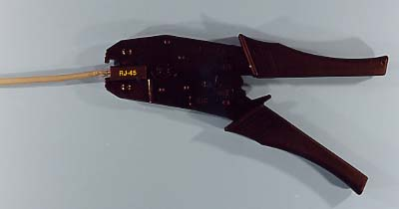
Crimp the Wire into the Connector

Slide 30
Crimp the Wire Into the Connector, Continued
Get a good crimper
Cheap ones often fail to make a good connection
Should have a ratchet for tightening without breaking the connector

Slide 31
RJ-45 Connector (Side View)
Strain Relief
Area for Crimping
Top
Back:
Hole for
UTP Cord
Front:
Connector
Pins
Spring Clip to
Hold Connector in

Slide 32
Crimp the Wire Into the Connector, Continued
Press down to make a good connection. If you press too lightly, the connection will not work
Crimping forces the pins on the front of the RJ-45 connector though the insulation, into each wire
  Called an insulation displacement connection (IDC)
This also crimps the cord at the back end of the connector for strain relief to keep the cord from pulling out if the cord is pulled
Now do it!

Slide 33
Connectorize Both Ends
White-orange is on the left (in Pin 1) at BOTH ENDS of the cord
  You do not reverse
  the order at the
  other end!
Pin 1 on this side
RJ-45
Connector
RJ-45
Jack

Slide 34
Test Your Cord

Slide 35
Test Your Cord
After you have connectorized both ends, test your cord
Misconnection is very common, so every cord must be checked
Inexpensive continuity testers make sure wires are connected electrically and in the right order
Expensive performance testers test for the quality of propagation

Slide 36
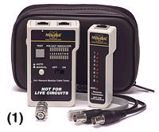
Test Your Cord, Continued
Continuity Tester
  Test for wires being in right slots and making good contact
  Place connectors of cord into two ends
  Hit Test button
  Did it work?
Now do it!

Slide 37
Test Your Cord, Continued
Now do it!
If It Didn’t Work
  Be sure you understand the problem
  If an open connection, one or more of the wires was not pushed all the way to the end or the crimping did not push the pin all the way through the insulation. Next time, cut the wires straight across and crimp very firmly
  If miswired, see where it was miswired
  Cut off the ends of the cord and reconnectorize

Slide 38
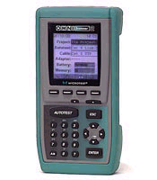
Test Your Cord, Continued
Signal Testers
  Expensive testers
  Test for signal quality
  Test for breaks with
  time domain
  reflectometry (TDR),
  which sends
  signals and looks for
  reflections that
  indicate breaks

